Slide 1


High-Level Synthesis with Game-Theoretic Scheduling
Power Optimization during Behavioral Synthesis
Presenter: Sumon Boiddo | Institute: Hochschule Hamm-Lippstadt
Scheduling
When operations run
Binding
Resource-operation assignment
Nash Equilibrium
Stable, optimal decisions
Results
Measured power savings

Slide 2




What is High-Level Synthesis?
High-Level Synthesis (HLS) automatically converts algorithmic descriptions written in high-level languages such as C or C++ into register-transfer level (RTL) hardware designs. It eliminates the need for manual gate-level design, dramatically reducing development time and designer effort.
Scheduling
Assign operations to control steps (clock cycles)
Allocation
Determine number and type of hardware resources needed
Binding
Map operations to specific functional units and registers
Together, these three steps translate an abstract algorithm into a concrete, synthesizable hardware netlist ready for FPGA or ASIC implementation.

Slide 3

Why Power Optimization Matters
The Challenge
Key Consequences of High Power
As silicon technology scales down, power consumption has become a first-class design constraint — not an afterthought. Every wasted switching event translates directly into heat, reduced battery life, and reliability degradation.
Faster battery drain in portable and IoT devices
Increased heat generation requiring expensive cooling
Higher packaging and thermal management costs
Reduced circuit reliability and lifespan
Thermal throttling, limiting peak performance
Embedded systems, sensors, wearables, and mobile SoCs are all critically affected by power budget decisions made during HLS.

Slide 4

The Core Problem in HLS
Naïve or suboptimal scheduling and binding decisions can significantly inflate power consumption. The root cause lies in unnecessary switching activity — every time a signal changes value, dynamic power is dissipated.
⏱ Scheduling
🔧 Allocation
🔗 Binding
Decides when each operation executes. Poor scheduling forces data to travel through extra logic, increasing transitions on interconnect and functional unit inputs.
Determines how many hardware resources are instantiated. Over-allocation creates idle units that still leak power; under-allocation causes congestion and pipeline stalls.
Maps operations to specific functional units and registers. Poor binding pairs operations with dissimilar inputs, maximizing bit-level transitions and power cost.
More switching activity → More dynamic power consumption. Optimal binding is the single largest lever for power reduction at the HLS stage.

Slide 5
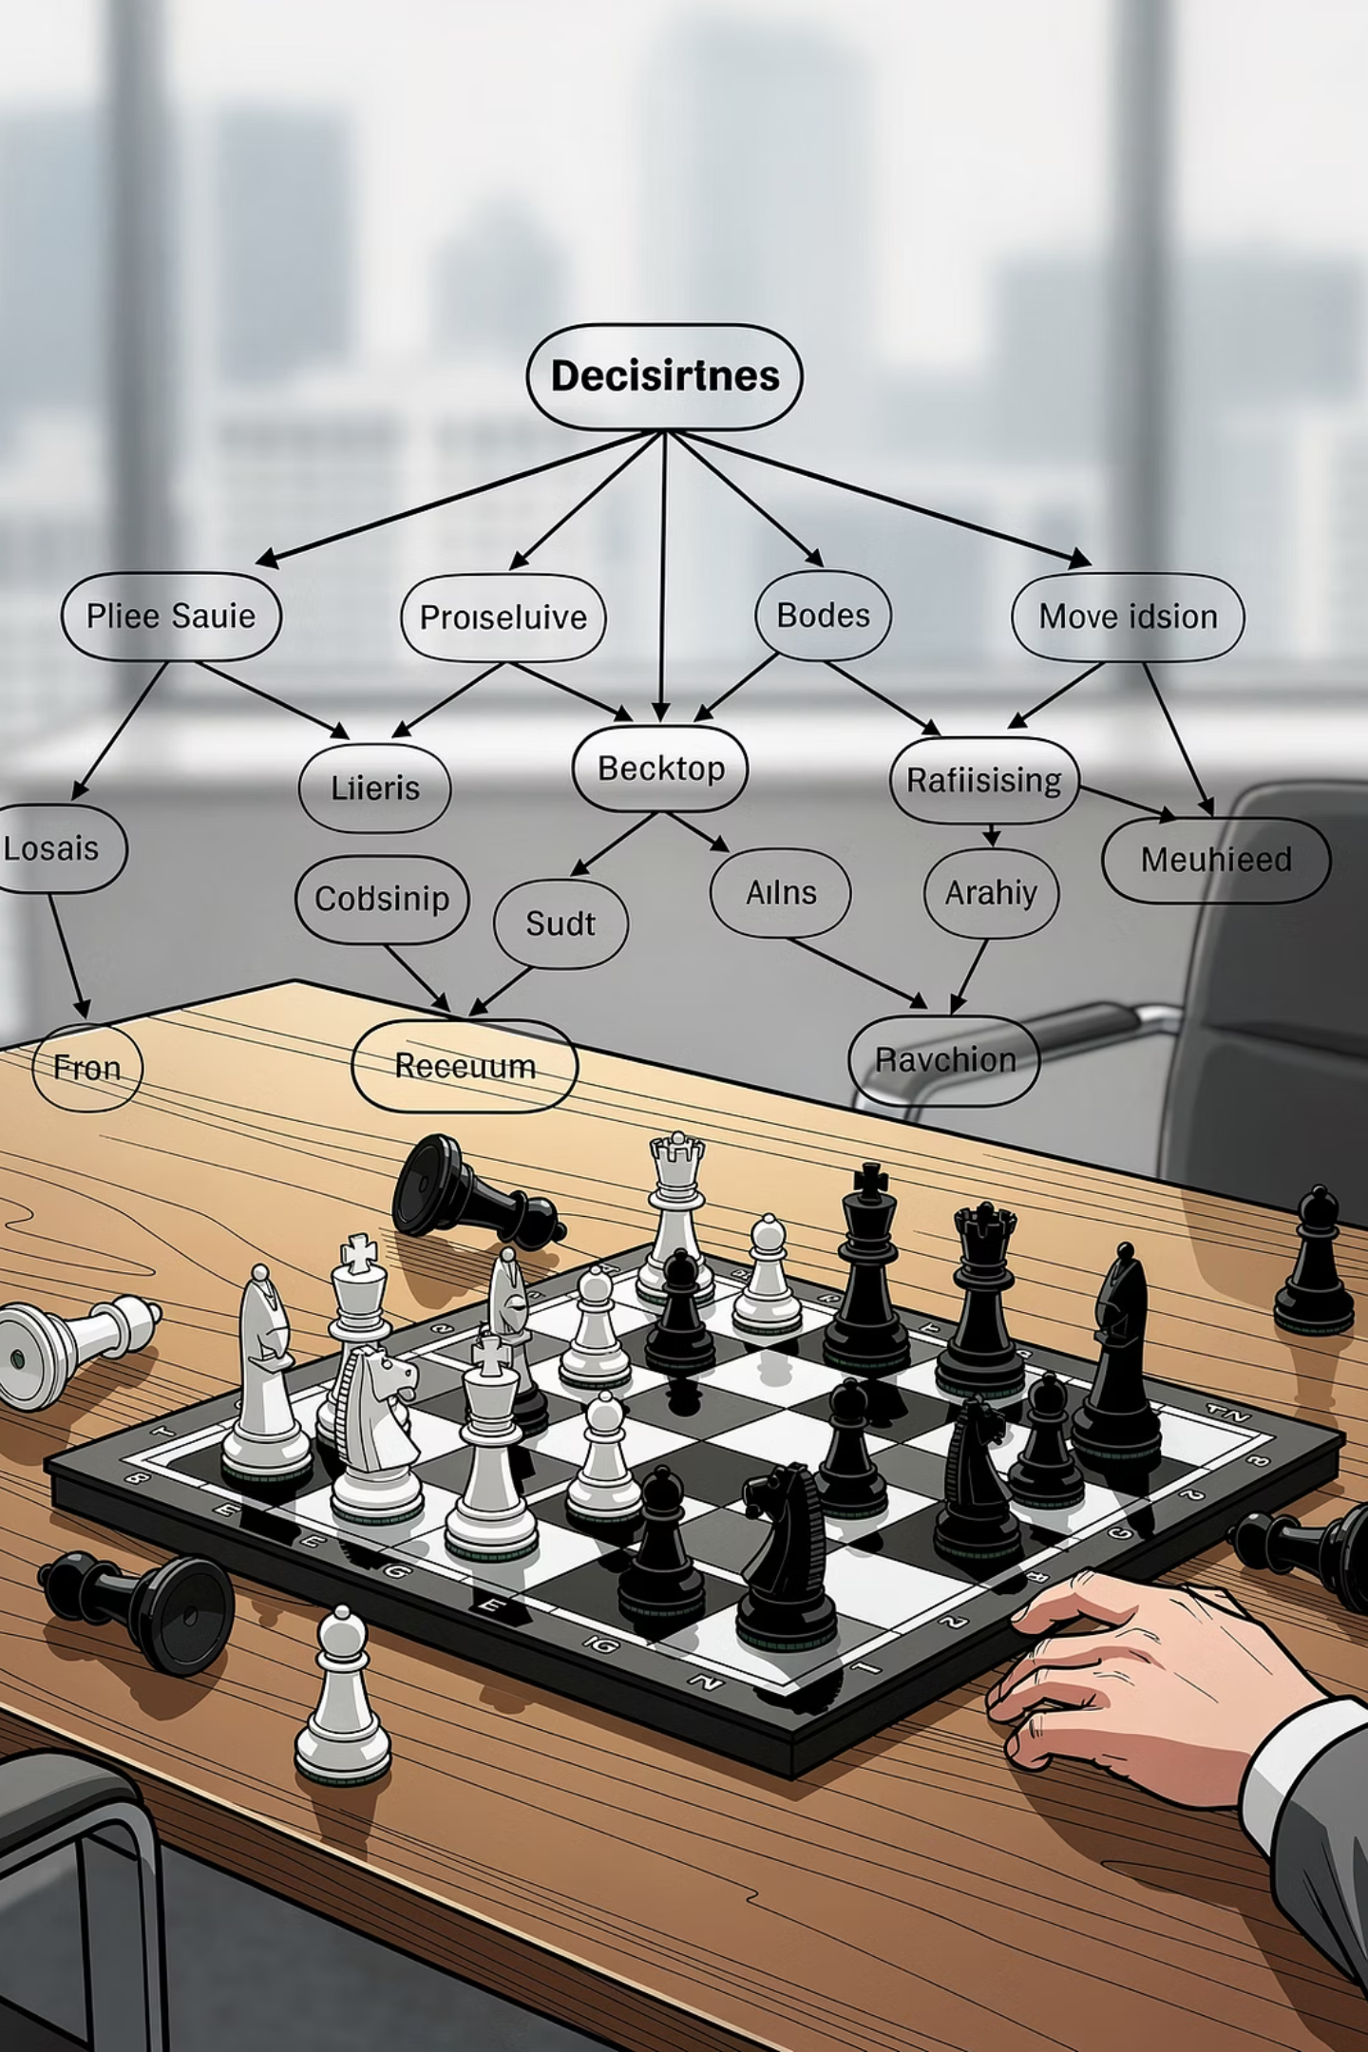
Why Use Game Theory?
Game theory provides a mathematically rigorous framework for decision-making when multiple agents compete for resources under conflicting objectives — exactly the situation in HLS binding.
Players
Functional units (adders, multipliers, ALUs) act as rational players, each seeking to minimize their individual power cost when assigned an operation.
Strategies
Each player's strategy is a bid representing the estimated switching power cost of executing a given operation on that specific unit.
Equilibrium
Nash equilibrium identifies the globally stable assignment — no unit can unilaterally reduce system power by switching to a different operation.

Slide 6

Auction-Based Scheduling Mechanism
The game-theoretic scheduler operates like a sealed-bid auction: operations are tasks to be assigned, and functional units submit power-cost bids. The unit with the lowest bid wins the operation assignment, minimizing switching activity at each scheduling step.
Bidding Example — Addition Operation
Why This Works
Functional Unit
Power Bid (mW)
Result
The bid value is not arbitrary — it is computed from the switching power model, accounting for input similarity between the operation and the unit's previous assignment. Units that have recently processed similar data have lower switching costs and naturally win relevant tasks.
Adder 1
8
❌ Not selected
Adder 2
5
❌ Not selected
Adder 3
3
✅ Winner
Encourages data locality in binding
Minimizes unnecessary bit-level transitions
Scales naturally to multiple resource types
Adder 3 wins because it shares the most common inputs with the operation, reducing bit transitions and power cost.

Slide 7

Nash Equilibrium — The Stable Solution
Nash equilibrium is the cornerstone of the game-theoretic approach. It defines a binding assignment where no single functional unit can reduce the overall system power by unilaterally changing its assigned operation.
Definition
In HLS Context
Guarantee
A set of strategies (one per player/unit) from which no player benefits by deviating alone. The system has reached a globally consistent, self-enforcing solution.
Each functional unit is assigned exactly the operation that minimizes mutual switching cost. Reassigning any single unit would only increase total power.
The equilibrium provides a provably stable and power-efficient binding. It replaces exhaustive search with a convergent iterative bidding process.
Nash equilibrium does not require a central controller — stability emerges naturally from the decentralized bidding interactions of the functional units.

Slide 8

Methodology: Step-by-Step Flow
Read DFG
Identify Ready Ops
X = A + B
Y = C + D
Z = X * Y
Equilibrium & Schedule
Units Submit Bids(Adder, Multiplier)
The algorithm processes the Data Flow Graph (DFG) level by level. Only operations whose predecessors have already been scheduled are considered "ready" and enter the bidding round. This ensures data dependencies are respected while minimizing switching activity at each step through the auction mechanism.

Slide 9

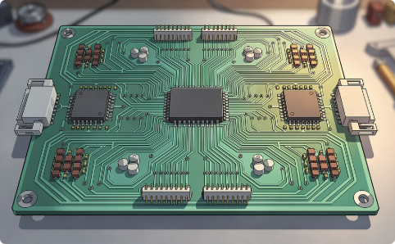

Three Key Power Reduction Techniques
Functional Unit Sharing
Path Balancing
Register Assignment
The same hardware unit is reused across multiple operations with similar data patterns. Reuse reduces the number of active units and dramatically cuts switching activity by keeping input values stable between consecutive operations.
Input signals to a functional unit are aligned to arrive simultaneously. Misaligned arrivals cause spurious transitions — the unit processes intermediate glitches before settling on the correct output, wasting power unnecessarily.
Values stored in registers are carefully assigned to minimize the Hamming distance between successive values read from or written to the same register. Fewer bit flips per register access directly lowers dynamic power in the storage network.
Simple example:
X arrives in cycle 1
Y arrives in cycle 3
Operation 1: A + B
Operation 2: A + C
0000
0001

Slide 10
Mathematical Foundation
The binding cost model quantifies how much switching power a specific operation-to-unit assignment incurs, accounting for input commonality with neighboring operations:
Binding Cost Function
Global Optimization Objective
P_sw — Switching power of the functional unit when executing operation o
P_inp — Power reduction gained from common or neighborhood inputs shared with adjacent operations
The algorithm searches across all feasible binding assignments A and selects A* — the assignment that achieves the minimum total binding cost across all scheduled operations.
In practice, the Nash equilibrium auction converges to A* efficiently without enumerating all possible assignments — unlike brute-force or ILP approaches.

Slide 11

Experimental Setup
Benchmark Circuits
Simulation Parameters
01
100,000 input vectors per benchmark for statistical accuracy
16-bit two's complement random integers as stimuli
Power measured using post-synthesis gate-level simulation
Compared against ILP-based scheduling and LP-based binding
Differential Equation
02
FIR Filter
Standard DSP benchmarks were chosen because they represent real-world compute-intensive applications where power efficiency is critical, such as signal processing in IoT and mobile devices.
03
IIR Filter
04
Lattice Filter
05
Elliptic Wave Filter
06
WAVE & Noise Cancel Filter

Slide 12
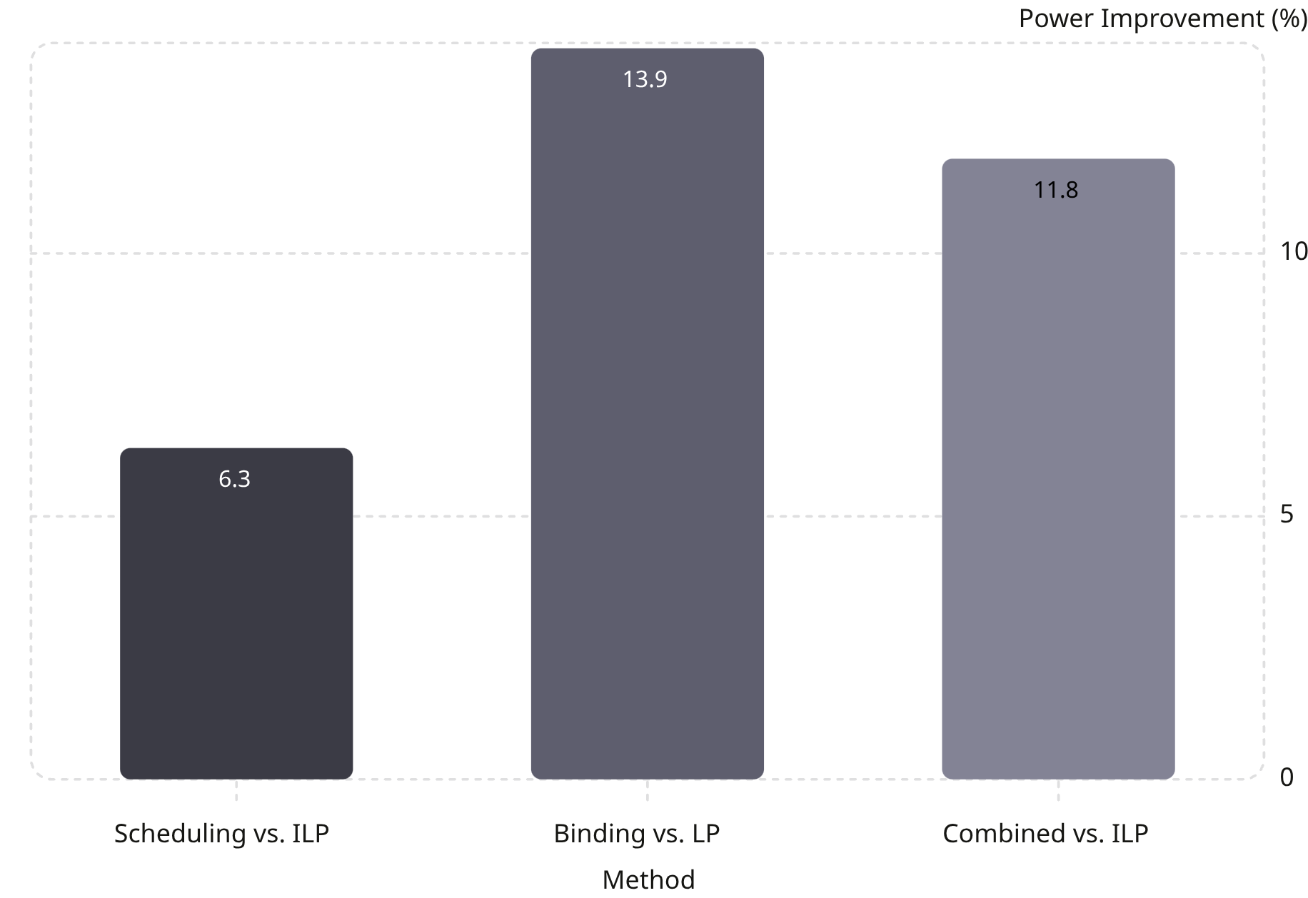

Experimental Results
Key Findings
6.3% — Scheduling
Game-theoretic scheduling outperforms classical ILP-based scheduling on power.
13.9% — Binding
Auction-based binding yields the largest individual improvement vs. LP binding.
11.8% — Combined
Joint scheduling + binding delivers strong end-to-end power savings.
Chip area did not increase. Runtime remained comparable to traditional methods.

Slide 13

Conclusion & References
Summary
References
HLS automates the translation of high-level code into optimized hardware
Scheduling and binding are the dominant levers for power control
Game theory models functional units as rational, power-minimizing players
Nash equilibrium produces a stable, provably efficient assignment
Results show up to 13.9% power reduction with no area penalty
Limitation: computational complexity grows with circuit size; slight latency increase observed in some benchmarks
[1] Murugavel & Ranganathan, 2003
A. K. Murugavel and N. Ranganathan, "A Game Theoretic Approach for Power Optimization During Behavioral Synthesis," IEEE Trans. VLSI Systems, vol. 11, no. 6, pp. 1031–1043, Dec. 2003.
[2] Sumon Boiddo, HSHL
S. Boiddo, "High-Level Synthesis with Game Theoretic Scheduling," Seminar Paper, Hochschule Hamm-Lippstadt
This approach is especially valuable for low-power embedded systems, IoT sensors, wearables, and mobile SoCs where every milliwatt matters.

Slide 14

Thank You for Your Attention

